Slide 1
Peer-graded Assignment: Capstone Project - The Battle of Neighborhoods (Week 2)
By Ramesh Rajamoni

Slide 2
Capstone Project - The Battle of Neighborhoods
Locate ideal neighborhood
Business Problem
In this modern age, Canada is a very popular immigration destination. Lots of people are migrating to various states of Canada and needed lots of information on good housing prices and reputed schools for their children.
This scope of this Project is to help Indians migrating to Toronto to identify a best neighborhood as a comparative analysis between neighborhoods.
The features used in analysis will be to identify neighborhoods where following facilities are mostly available nearby like school, shops, transport facilities, Indian restaurants, medical facilities etc
Thus our business problem to solve is, which neighborhood is ideal to move in for a Indian immigrant.

Slide 3
Capstone Project - The Battle of Neighborhoods
Locate ideal neighborhood
Approach
This project will utilize publicly available data from Wikipedia and Foursquare.
Specifically, all Toronto neighborhood details along with their postal codes are available here: https://en.wikipedia.org/wiki/List_of_postal_codes_of_Canada:_M
The focus of this project will be to acquire data by using web scraping method of python and then clean the data, populate the data then use foursquare API to collect the data of the all the neighborhood places then use k-means clustering method to find the best fit.

Slide 4
Capstone Project - The Battle of Neighborhoods
Locate ideal neighborhood
Data and EDA
Get the data from wiki portal - https://en.wikipedia.org/wiki/List_of_postal_codes_of_Canada:_M and prepare it.
Get the location coordinates from - https://cocl.us/Geospatial_data
Merge both the data to arrive at our source of data.
Following data sources will be needed to extract/generate the required information:
Group the neighborhoods based on postal code and use K-means clustering to analyze and visualize the data.
Location details like latitude and longitude details are fetched from remote location, alternatively they can also be retrieved from Google Maps API.
Fetch the facilities like Restaurants, Bus Stations, Schools, Coffee shops, Grocery Shops etc in every neighborhood using Foursquare API
Identify the neighborhood which matches our requirement - having most of preferred facilities, and recommend it to the customer.

Slide 5
Capstone Project - The Battle of Neighborhoods
Locate ideal neighborhood
Clean Up
Set all ‘Not Assigned’ valued neighborhoods with same value as Boroughs field, to standardize the data.
Use the IsNan() to find and clean up empty data.
Sorted and indexed the data, for using with FourSquare APIs.
Have encoding for the Venue Categories to process the data.
The neighborhood details data was merged with the geospatial data and a consolidated file was created for further use.
Folio Map was used to visualize the data.
.

Slide 6
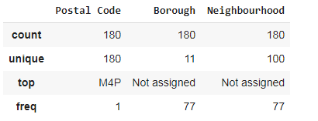
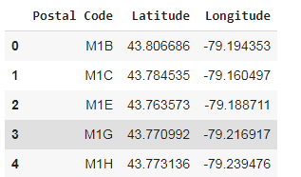
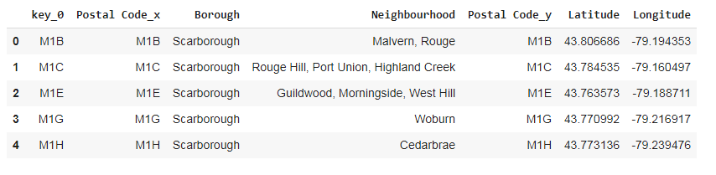
Capstone Project - The Battle of Neighborhoods
Locate ideal neighborhood
Data

Slide 7
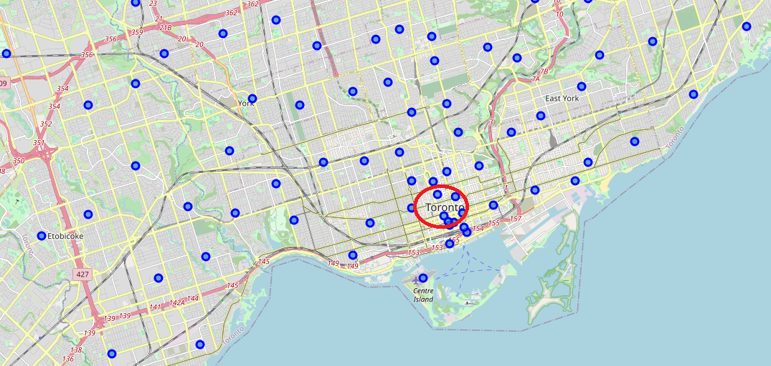
Capstone Project - The Battle of Neighborhoods
Locate ideal neighborhood
Folium mapping feature was used to plot the maps

Slide 8
Capstone Project - The Battle of Neighborhoods
Locate ideal neighborhood
Solution
To Analyze the data, pick identify the features and work on those column data, like grouping and sorting them, and joining the similar fields.
Then I use the Folium’s mapping methods to plot the data on to a map for visualization.
K-means clustering is employed to arrive at the required result of identifying the neighborhood which matches to the customers requirement – that is a neighborhood which has the most number of facilities in a set of expected/required facilities.
These facilities (venue details) are fetched for each postal code (location) using Four Square APIs.
.

Slide 9
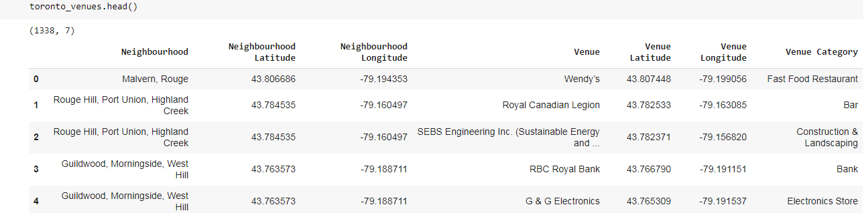
Capstone Project - The Battle of Neighborhoods
Locate ideal neighborhood
FourSquare APIs
An FourSquare account and use it to register and consume the api.
A typical call to the API will look like
'https://api.foursquare.com/v2/venues/explore?&client_id={}&cli..’
Sample result from the API

Slide 10
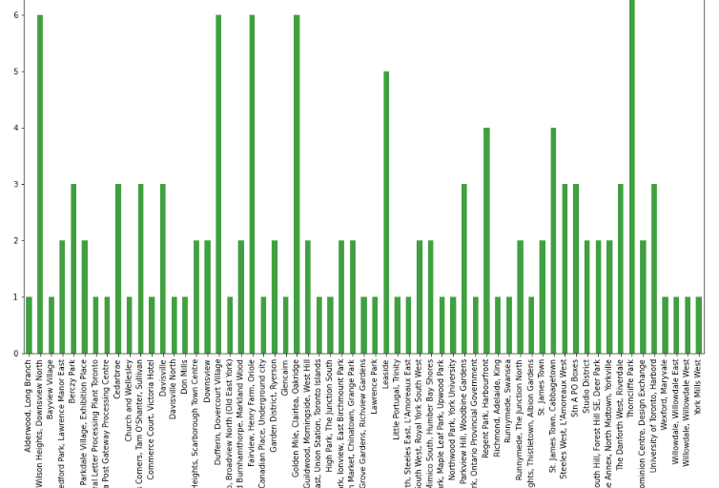
Capstone Project - The Battle of Neighborhoods
Locate ideal neighborhood
Visualize the output
using a histogram

Slide 11
Capstone Project - The Battle of Neighborhoods
Locate ideal neighborhood
Conclusion
Finally, by leveraging the Foursquare API and K-Means clustering,
we are able to pick a neighborhood which can be recommended
for Indian Immigrants to Toronto – solution to our business problem!

